Slide 1
Part 5 Modern TCP and IP

Slide 2
Evaluation du premier projet
Deadline slides de base
Vendredi 14 mars 20h
Relisez les questions reprises dans l’énoncé !
Evaluations
Jeudi 10h45-13h45: Syncthing (ou vendredi temps de midi si necessaire)
Jeudi 10h45-13h45: Magic Wormhole (ou vendredi temps de midi si necessaire)
Jeudi 16h15-18h15: Croc
Vendredi 10h45-13h45: Screego
Agenda sera ouvert lundi 17 mars sur moodle pour réservation de slots
Pas de séance de TP les 20-21 mars

Slide 3
Agenda
TCP
Improvements to the three-way handshake
Improvements to the data transfer
Congestion control (will be discussed later)
Multipath TCP (will be discussed later)
IPv6
IPv4

Slide 4
TCP segment
32 bits
Flags :
used to indicate the function of a segment
SYN : used during establishment
FIN : used during connection release RST : used in case of problems
ACK : if true, means that the Acknowledgement number inside the segment is valid
Source port
Destination port
Sequence number
Acknowledgement number
20 bytes
THL Reserved Flags
Window
Checksum
Urgent pointer
Optional header extension
Segment header length
Payload
Computed over the entire segment and part of the IP header
Notes:
Urgent pointer is rarely used and will not be described.
The THL is indicated in blocs of 32 bits. The TCP header may contain options, these will be discussed later.

Slide 5
Three-way handshake : initial specification
X is extracted from a local clock incremented every 4 musec
CONNECT.req
Initial sequence number (x)
SYN(seq=x)
CONNECT.ind
CONNECT.resp
CONNECT.conf
SYN+ACK(ack=x+1,seq=y)
Initial sequence number (y)
Connection established
The sequence numbers of all segments A->B will start at x+1
ACK(seq=x+1, ack=y+1)
Connection established
?
Y is extracted from a local clock incremented every 4 musec
The sequence numbers of all segments B->A will start at y+1
Can you improve TCP’s connection establishment ?
Notes:
MSL in IP networks : 120 seconds

Slide 6
Three-way handshake today
X is random
CONNECT.req
Initial sequence number (x)
SYN(seq=x)
CONNECT.ind
CONNECT.resp
CONNECT.conf
SYN+ACK(ack=x+1,seq=y)
Initial sequence number (y)
Connection established
The sequence numbers of all segments A->B will start at x+1
ACK(seq=x+1, ack=y+1)
Connection established
Y is random
The sequence numbers of all segments B->A will start at y+1
Notes:
MSL in IP networks : 120 seconds

Slide 7
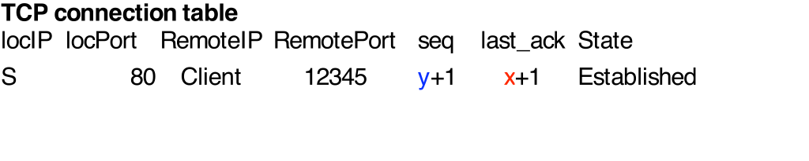

TCP connection establishment
CONNECT.req
SYN(seq=x)‏
CONNECT.ind
SYN+ACK(ack=x+1,seq=y)‏
ACK( seq=x+1, ack=y+1)‏
Server needs to maintain a connection table to check returned ack

Slide 8
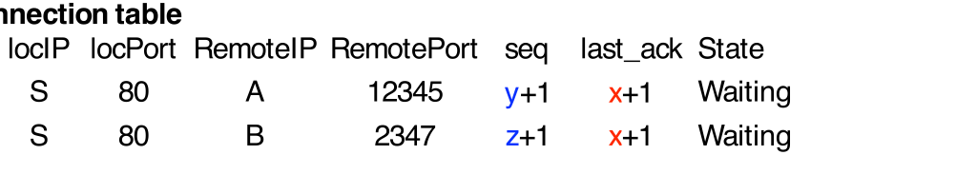
DoS attack
Attacker sends 1000s of (spoofed) SYNs
SYN(Src=A,seq=x)‏
CONNECT.ind
SYN+ACK(Dest=A,ack=x+1,seq=y)‏
SYN(Src=B,seq=x)‏
CONNECT.ind
SYN+ACK(Dest=B,ack=x+1,seq=z)‏
Some servers restrict the number of connections in the waiting state
Notes:
Most TCP implementations today have fixes for those problems. We will discuss them later.

Slide 9
Countering DoS attacks
Principle of the solution
Server should not create any state before being sure that the client can receive the segments that it sends
Server does not store anything
CONNECT.req
SYN(Src=C,seq=x)‏
SYN+ACK(Dest=C,ack=x+1,seq=y)‏
ACK(Src=A,seq=x, ack=y+1)‏
Server checks that third ACK is valid
and creates state
Notes:
Most TCP implementations today have fixes for those problems. We will discuss them later.

Slide 10
SYN Cookies
Server verifies third ack without any state
CONNECT.req
SYN(seq=x)‏
CONNECT.ind
No state created
y=Hash(IP_{Client},Port_{Client},Secret)‏
?
How should the server select y ?
CONNECT.conf
SYN+ACK(ack=x+1,seq=y)‏
ACK(seq=x+1, ack=y+1)‏
Verify that
ack=1+Hash(IP_{Client},Port_{Client},Secret)‏
State is created
Notes:
This utilization of a hash function to compute the value of the initial sequence number is usually called a SYN cookie.
In practice, the computation of the SYN cookie is slightly more complex than a simple hash function because the server must also remember inside the cookie the following information :
- the MSS value advertised by the client
- the optional utilization of TCP options such as RFC1323 large windows or timestamps or SACK by the sender
The original discussions that lead to the development of the SYN cookie solution may be found in :
http://cr.yp.to/syncookies/archive

Slide 11
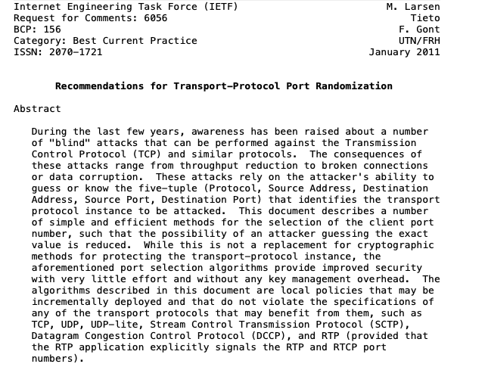
Simultaneous open
Is this frequent in practice ?
How does a client selects its source port ?

Slide 12
TCP options
32 bits
Space in the header with new fields which can be exchanged over a connection
Source port
Destination port
Sequence number
Acknowledgement number
20 bytes
THL Reserved Flags
Window
Checksum
Urgent pointer
Caveat: header extension cannot be longer than 40 bytes
Optional header extension
Payload
Each TCP Option encoded as:
Type
Length
Value
Notes:
Urgent pointer is rarely used and will not be described.
The THL is indicated in blocs of 32 bits. The TCP header may contain options, these will be discussed later.

Slide 13
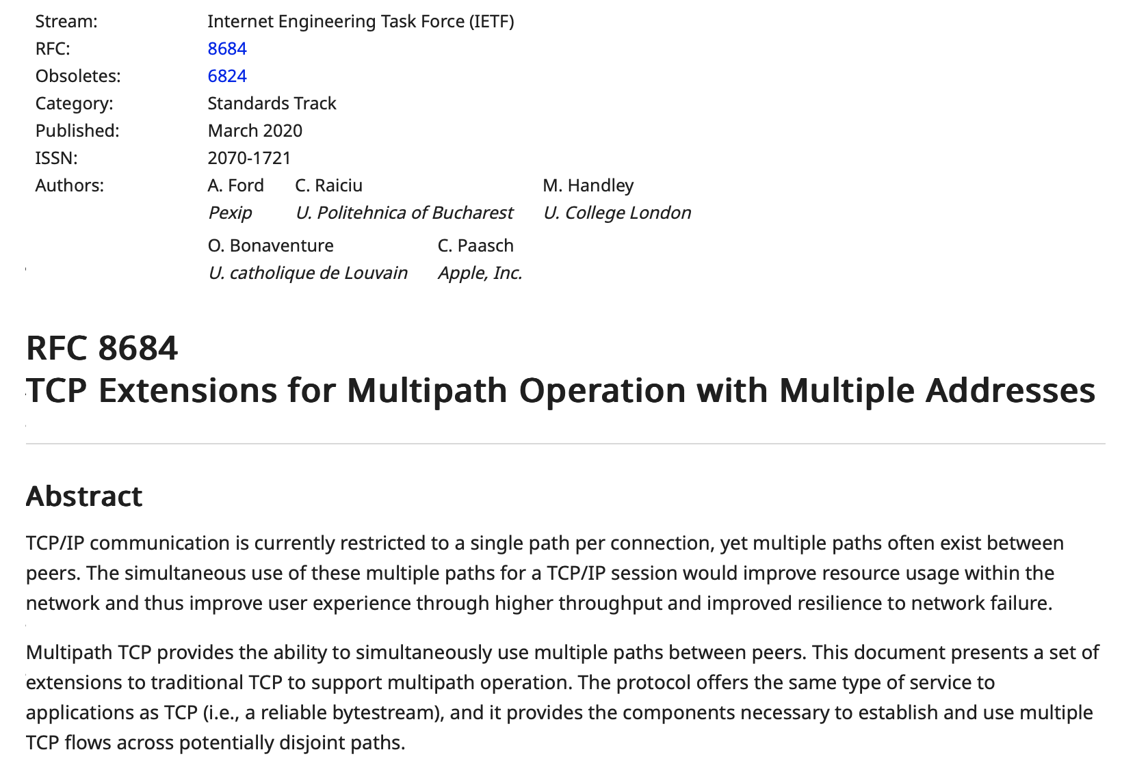
TCP options
Maximum Segment Size
Selective acknowledgements
Window Scale
Timestamps
Multipath TCP
...

Slide 14
Negotiating the utilization of TCP Options
CONNECT.req
Initial sequence number (x)
Option K proposed
SYN(seq=x),Option K
CONNECT.ind
CONNECT.resp
CONNECT.conf
SYN+ACK(ack=x+1,seq=y) Option K
Initial sequence number (y)
Option K accepted
Connection established
Option K accepted
The sequence numbers of all segments A->B will start at x+1
ACK(seq=x+1, ack=y+1)
Connection established
The sequence numbers of all segments B->A will start at y+1
Notes:
MSL in IP networks : 120 seconds

Slide 15
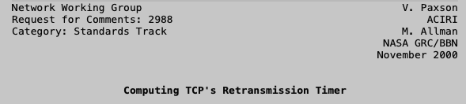
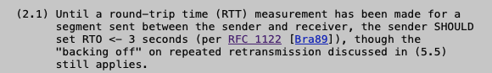
Protection against SYN losses
Which retransmission timer should we use when sending the first SYN ?

Slide 16
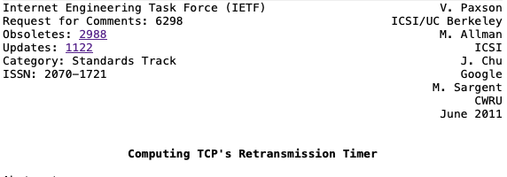
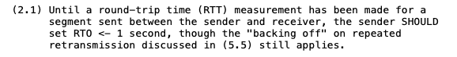
Faster reaction to SYN losses

Slide 17
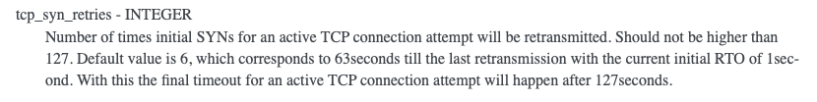
SYN retransmissions
How often are SYN segments retransmitted ?
Linux
https://www.kernel.org/doc/html/latest/networking/ip-sysctl.html

Slide 18

Latency matters
Can we we reduce the overhead of the three-way handshake ?
Putting data inside SYN and SYN+ACK
https://www.gigaspaces.com/blog/amazon-found-every-100ms-of-latency-cost-them-1-in-sales/

Slide 19
A short HTTP request takes two rtts
SYN(seq=x)
TCP handshake
SYN+ACK(ack=x+1,seq=y)
?
Can we reduce the total delay ?
ACK(seq=x+1, ack=y+1)
GET /index.html …
First HTTP Request
ACK(ack=x+33,seq=y+1)
HTTP/1.1 200 OK …
Notes:
MSL in IP networks : 120 seconds

Slide 20

TCP Fast Open
SYN(seq=x)
HTTP GET ‏
CONNECT.req+Data
CONNECT.ind+HTTP GET
SYN+ACK(ack=x+1,seq=y)
HTTP Resp ‏
ACK(ack=y+1seq=x)‏
Is this safe ?
Risk of denial of service attack

Slide 21
Safe TCP Fast Open
How to make TCP Fast Open safe in the presence of attackers ?
Server needs to ensure that SYN segment does not come from an attacker who sent a spoofed packet
?
How would you design such a solution ?

Slide 22
TCP Fast Open
First connection from client unsafe
SYN(seq=x)
FastOpen()GET /…
?
What is the information returned by the server in the FastOpen option ?
SYN+ACK(ack=x+1,seq=y)
FastOpen(0x65df)
New connection
Data delivered and acked, 2 rtt
ACK(seq=x+1, ack=y+1)
GET /…
SYN(seq=z)
FastOpen(0x65df) GET /…
SYN+ACK(ack=z+24,seq=w)
FastOpen(0x65df)
Second safe connection
Data delivered and acked, 1 rtt
Data (seq=w+1, <html> ….)
https://www.rfc-editor.org/rfc/rfc7413

Slide 23
Agenda
TCP
Improvements to the three-way handshake
Improvements to the data transfer
Congestion control (will be discussed later)
Multipath TCP (will be discussed later)
IPv6
IPv4

Slide 24
Delayed acknowledgments
Sending one ack per segment is costly
Tradeoff
In sequence data segment
no ack waiting, delay by up to 50 msec
one ack waiting, send immediately
Out-of-sequence data segment
send ack immediately
?
What is the benefit of delayed acks ?

Slide 25
When to send a segment with data ?
When should a segment be sent ?
Option 1
After each write system call
Lowest delay for application
Option 2
When there is a full segment of data
Lowest overhead for network

Slide 26
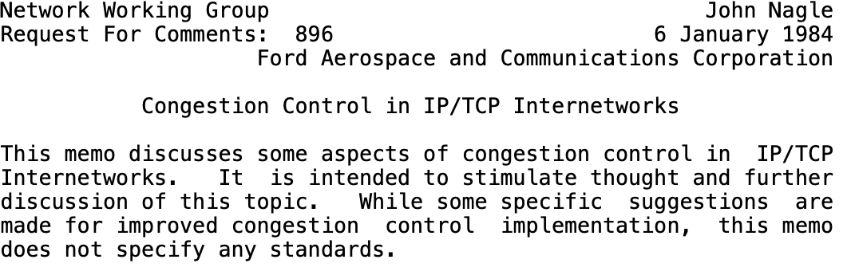
Nagle algorithm
A new data segment can be sent if either
This is a full segment (MSS bytes)
There are no unacknowledged bytes
https://www.rfc-editor.org/rfc/rfc896

Slide 27
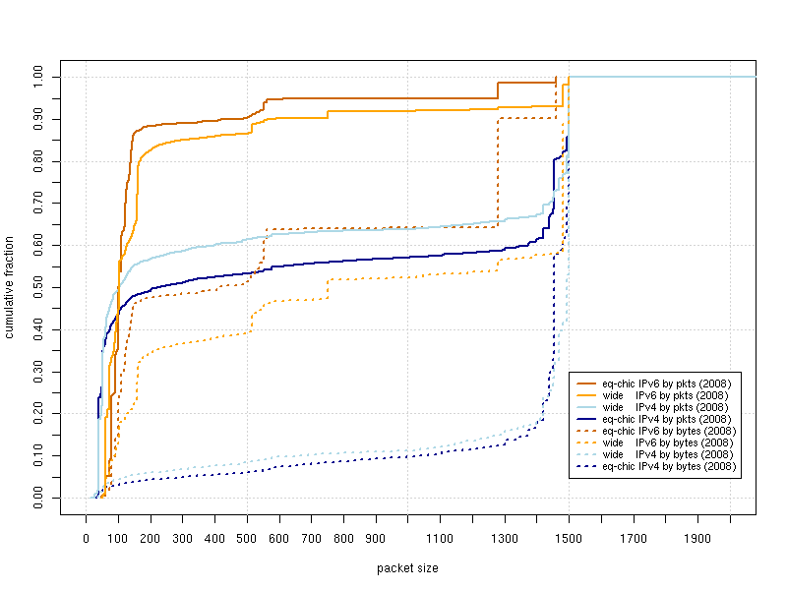
Observed IP packets
http://www.caida.org/research/traffic-analysis/pkt_size_distribution/graphs.xml

Slide 28
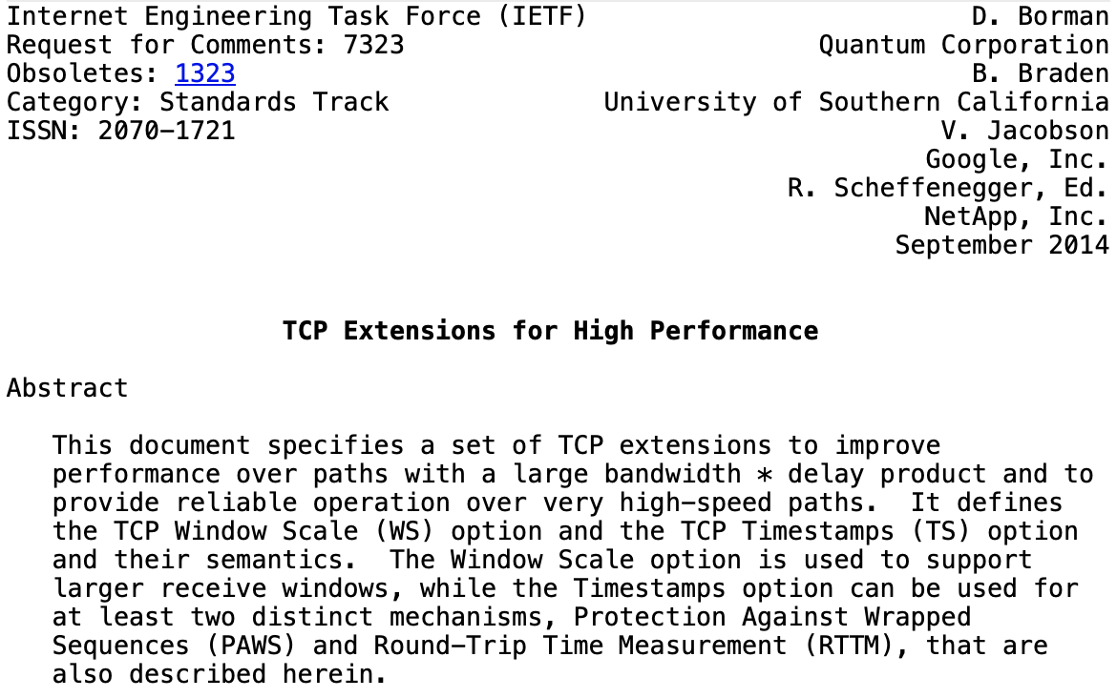
TCP Timestamps extension
Objective
Add two 32 bits timestamps to each TCP segment
TSVal is the current timestamp of the sender when sending the segment
TSecr is the last timestamp received from the remote host
Two different roles
Improve rtt measurements
Protection Against Wrapped Sequence Numbers (PAWS)

Slide 29
Negotiating the utilization of TCP Timestamps
Initial sequence number (x)
Current timestamp: 123
Last timestamp received ??
SYN(seq=x)
TSval=123, TSecr=456
SYN+ACK(ack=x+1,seq=y)
TSval=789, TSecr=123
Initial sequence number (y)
Current timestamp: 789
Last timestamp received : 123
Current timestamp: 124
Last timestamp received 123
ACK(seq=x+1, ack=y+1)
Tsval=124, Tsecr=789
Current timestamp: 791
Last timestamp received : 124
Notes:
MSL in IP networks : 120 seconds

Slide 30
RTT estimation Timestamp option
(seq=120,TS=1, TS echo=7, "xyz")
measured rtt
(ack=123, TS=12, TS echo=1)
(seq=123,TS=3, TS echo=12, "abcd")
timer
(seq=123,TS=5, TS echo=12, "abcd")
measured rtt
(ack=127, TS=17, TS echo=3)
Notes:
Les timestamps TCP ont étés introduits dans :
RFC1323 TCP Extensions for High Performance. V. Jacobson, R. Braden, D. Borman. May 1992.
L'utilisation de ces timestamps est négociée lors de l'établissement de la connexion TCP. La plupart des implémentations TCP actuelles supportent ces extensions.

Slide 31
TCP flow control
Performance function of window size
Throughput ~= window/rtt
TCP window : 16 bits field
rtt 1 msec 10 msec 100 msec
Window
8 Kbytes 65.6 Mbps 6.5 Mbps 0.66 Mbps
64 Kbytes 524.3 Mbps 52.4 Mbps 5.2 Mbps

Slide 32
RFC1323 Window scaling
Window maintained as a 32 bits integer by TCP implementations
But sent as a scaled 16 bits in segments
Scaling factor announced in WScale option in SYN/SYN+ACK segments
Client and server can use different scaling values
32 bits
32 bits receive window << scale
Source port
Destination port
Sequence number
Window
Acknowledgement number
THL Reserved Flags
Window
Checksum
Urgent pointer
Optional header extension
Payload

Slide 33
Benefits and limitations of Window Scaling
Increases maximum sending and receiving windows
Largest possible value is 2³⁰ bytes
Enables TCP to operate at higher bandwidth
Within MSL seconds, a TCP sender can send several times the same sequence number !
Need an efficient technique to detect duplicates
rtt 1 msec 10 msec 100 msec
Window
8 Kbytes 65.6 Mbps 6.5 Mbps 0.66 Mbps
64 Kbytes 524.3 Mbps 52.4 Mbps 5.2 Mbps
1 Mbytes 8.39 Gbps 839 Mbps 83.9 Mbps
1 Gbytes 8589 Gbps 859 Gbps 85.9 Gbps

Slide 34
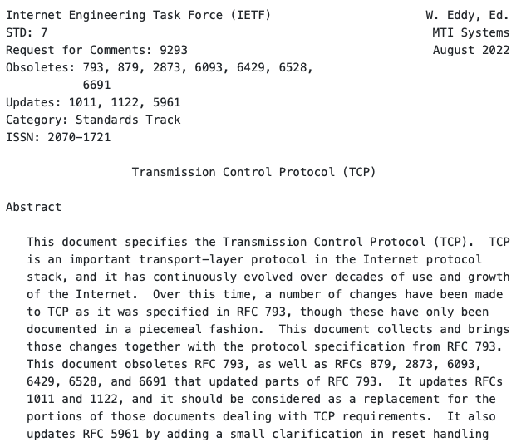
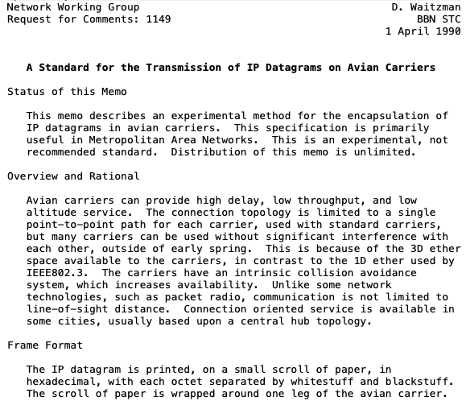
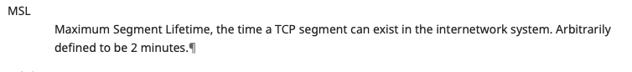
The Maximum Segment Lifetime

Slide 35
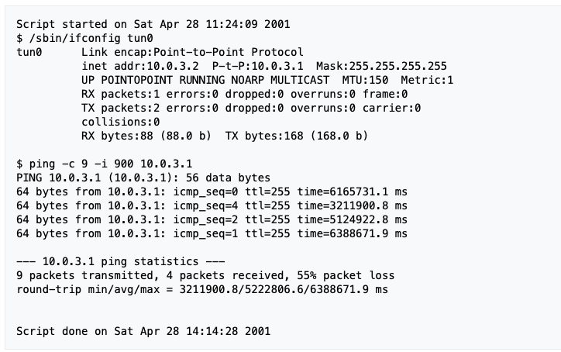
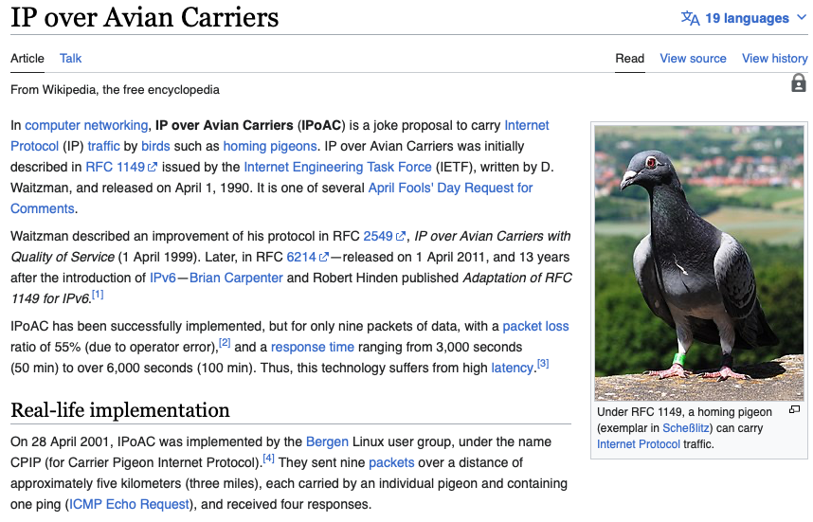
IP over avian carriers

Slide 36
Protection against wrapped sequence numbers
TCP’s reliable delivery assumes that segments do not survive for more than MSL seconds in the network
TCP uses 32 bits sequence numbers that wrap after 4 GBytes
Can a host send segments with the same sequence number within less than MSL seconds ?
At 1 Mbps, a host sends 4 GBytes within 34359 seconds
At 1 Gbps, a host sends 4 GBytes within 34 seconds
At 100 Gbps, a host sends 4 GBYtes within 0.34 seconds

Slide 37
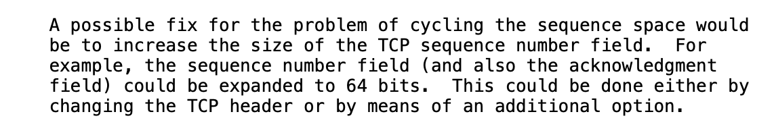
Possible solutions
Clean-slate approach
Extend TCP to use 64 bits sequence numbers
RFC1323 solution in 1992
Changing TCP sequence number is too complex
Require TCP timestamp options when TCP is used at high speed
Receiver uses TCP timestamps to detect delayed segments
https://www.rfc-editor.org/rfc/rfc1323

Slide 38
Selective acknowledgments
Receiver can indicate the sequence numbers that it has received when there are gaps
Negotiated during the three-way handshake
Initial sequence number (x)
SACK proposed
SYN(seq=x)
SACK-Permitted
SYN+ACK(ack=x+1,seq=y)
SACK Permitted
Initial sequence number (y)
SACK enabled
SACK enabled
ACK(seq=x+1, ack=y+1)
Tsval=124, Tsecr=789

Slide 39
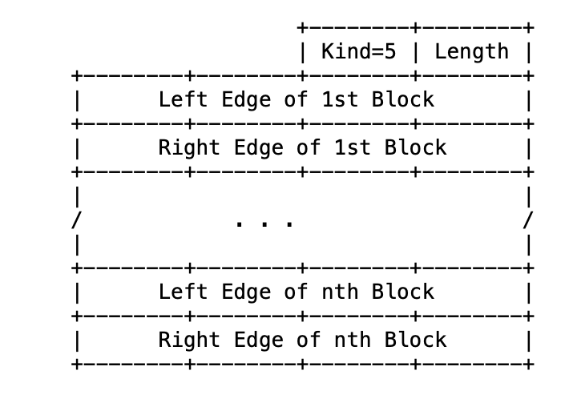

Selective Acknowledgments
Receiver reports SACK blocks
(ack=123)
(seq=123,"abcd")
(seq=127,"ef")
Lost
How many SACK blocks in a TCP header ?
(ack=123,sack:127-128)
(seq=129,"gh")
(ack=123, sack:127-130)
Given the space available in the TCP header, receiver cannot usually report more than 3 SACK blocks
(seq=131,"ij")
(ack=123, sack:127-132)
only 123-126 must be retransmitted
(seq=123,"abcd")
(ack=133)
"abcdefghij"
Notes:
RFC2018 TCP Selective Acknowledgement Options. M. Mathis, J. Mahdavi, S. Floyd, A. Romanow. October 1996.

Slide 40
Improvements to Fast retransmit
(ack=123)
(seq=123,"abcd")
(seq=127,"ef")
(ack=123)
Out of sequence, in buffer
(seq=129,"gh")
(ack=123)
Out of sequence, in buffer
(seq=131,"ij")
(ack=123)
Out of sequence, in buffer
(seq=123,"abcd")
(ack=133)
"abcdefghij"
The initital design used a duplicate ack threshold of 3 to cope with reordering. Modern implementations leverage selective acknowledgements and dynamically adjust the duplicate ack threshold based on observed reordering.
Notes:
See e.g.
RFC2001 TCP Slow Start, Congestion Avoidance, Fast Retransmit, and Fast Recovery Algorithms. W. Stevens. January 1997.

Slide 41
Selective Acks
Receiver reports SACK blocks
Negotiated during establishment
How many SACK blocks
in one TCP segment ?
(ack=123)
(seq=123,"abcd")
(seq=127,"ef")
Lost
(ack=123,sack:127-128)
(seq=129,"gh")
(ack=123, sack:127-130)
(seq=131,"ij")
(ack=123, sack:127-132)
only 123-126 must be retransmitted
(seq=123,"abcd")
(ack=133)
"abcdefghij"
Notes:
RFC2018 TCP Selective Acknowledgement Options. M. Mathis, J. Mahdavi, S. Floyd, A. Romanow. October 1996.

Slide 42
RACK and Tail Loss Probe
Problem
The loss of the last segment of a block of data may have a large impact on the performance
DATA.req (”GET /index.html")
(seq=123,”GET /")
(ack=128)
DATA.ind(”GET /")
(seq=128,”index.html\r\n")
(seq=140,”Host:…")
https://www.rfc-editor.org/rfc/rfc8985.html

Slide 43
RACK and Tail Loss Probe
Two main ideas, but many tiny details
RACK
Sender maintains a timestamp for each transmitted segment
Sender estimates a reordering window (smaller than rtt) to cope with reordering
Thanks to SACK, sender can update reordering window and considers that segments that have not been acked within rtt+reordering window have been lost
RACK applied to both new segments and retransmissions

Slide 44
Tail Loss Probe
Main idea
If a sender has some unacknowledged data but did not receive enough acks to trigger a retransmission, it can resend a segment to probe the receiver
Short PTO timeout
DATA.req (”GET /index.html")
(seq=123,”GET /")
(ack=128)
DATA.ind(”GET /")
(seq=128,”index.html\r\n")
PTO
(seq=140,”Host:…")
(seq=140,”Host:…")
(ack=128, SACK(140,168)
Segment 128 can be retransmitted
(seq=128,”index.html\r\n")

Slide 45
Agenda
TCP
Improvements to the three-way handshake
Improvements to the data transfer
Congestion control (will be discussed later)
Multipath TCP (will be discussed later if time permits)
IPv6
IPv6 Addresses
IPv6 Packets
ICMPv6
IPv4

Slide 46



Hosts and routers
Host
Routers
A host
Sends new IP packets with its address as their source
Receives IP packets with its address as their destination
A host has a least one network interface, sometimes more
A router mainly
Forwards IP packets created by other hosts so that they can reach their final destination
Rarely send new IP packets or receive IP packets destined to itself
A router has several network interfaces
R2

Slide 47
IPv6 addresses
IPv4
IP version 6
Each IPv6 address is encoded in 128 bits
3.4 x 10^38 possible addressable devices
6.65 x 10^23 addresses per square meter
Why 128 bits ?
What is percentage of IPv6 users in Belgium ?
Notes:
IP version 4 supports 4,294,967,296 distinct addresses, but some are reserved for :
private addresses (RFC1918)
loopback (127.0.0.1)
multicast
...

Slide 48
IP addresses identify network interfaces
An IP address identifies an attachment point of a host to the network
A computer equipped with a single Ethernet interface will have one IP address associated to this interface
One IPv4 and one IPv6 address if the network is dual-stack
A smartphone equipped with a cellular and a Wi-Fi interface will have
One IP address associated to the Wi-Fi interface
One IP address associated to the cellular interface
A router will have an address on each of its network interfaces

Slide 49
IPv6 Addressing architecture
Unicast addresses
An identifier for a single interface. A packet sent to a unicast address is delivered to the interface identified by that address
Anycast addresses
An identifier for a set of interfaces.
Multicast addresses
An identifier for a set of interfaces. A packet sent to a multicast address is delivered to all interfaces identified by that address.
Notes:
The IPv6 addressing architecture is defined in :
R. Hinden, S. Deering, IP Version 6 Addressing Architecture, RFC4291, February 2006

Slide 50
Textual representation of IPv6 addresses
Hexadecimal format
FEDC:BA98:7654:3210:FEDC:BA98:7654:3210
1080:0:0:0:8:800:200C:417A
Compact hexadecimal format
Some IPv6 addresses contain lots of zero
use "::" for one or more groups of 16 zeros.
1080:0:0:0:8:800:200C:417A = 1080::8:800:200C:417A
FF01:0:0:0:0:0:0:101 = FF01::101
0:0:0:0:0:0:0:1 = ::1

Slide 51
IPv6 unicast addresses
128 bits
N bits
M bits
128-N-M bits
interface ID
global routing prefix
subnet ID
Can be used to identify the
ISP responsible for this address
Usually 64 bits
Random or based on MAC Address
A subnet in this ISP or a customer of this ISP
Notes:
Today, the default encoding for global unicast addresses is to use :
48 bits for the global routing prefix (first three bits are set to 001)
16 bits for the subnet ID
64 bits for the interface ID

Slide 52
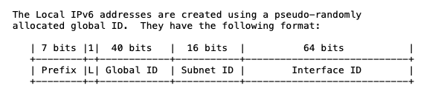
Some IPv6 addresses and prefixes
Loopback : ::1/128
Link local : FE80::/10
Local IPv6 addresses : FC00::/7
https://www.rfc-editor.org/rfc/rfc4193

Slide 53
Public IPv6 addresses and prefixes
www.facebook.com : 2a03:2880:f121:83:face:b00c:0:25de
UCLouvain’s DNS resolvers
2001:6a8:3081:1::53, 2001:6a8:3081:2::53, 2001:6a8:3082:1::53
Quad9’s public DNS resolvers : 2606:4700:4700::1111 and 2606:4700:4700::1001
Belnet’s network prefix : 2001:6a8::/32
Proximus’ network prefix : 2a02:a000::/26
Voo’s network prefix : 2a02:2788::/32
Orange’s network prefix : 2a01:c780::/32

Slide 54
Finding the owner of an IPv6 address
Address blocks are allocated by IANA to regional registries
RIPE, ARIN, APNIC, AFRINIC, LACNIC https://www.iana.org/assignments/ipv6-unicast-address-assignments/ipv6-unicast-address-assignments.xhtml
Regional registries assign prefixes to ISPs and enterprises
RIPE https://www.ripe.net/publications/docs/ripe-738#ir
/32 or larger for ISP
/48 for small enterprise
ISPs should allocate /56 for home users
Whois databases provide information about allocated addresse blocks

Slide 55
Using whois
Example : www.belgium.be
dig -t AAAA +short www.belgium.be
2a01:690:35:100::f5:79
whois 2a01:690:35:100::f5:79
% This is the RIPE Database query service.
% The objects are in RPSL format.
% …
% Abuse contact for '2a01:690::/29' is 'network@smals.be'
inet6num: 2a01:690::/29
netname: BE-SMALS-MVM-20071203
country: BE
org: ORG-SA112-RIPE
admin-c: SRO8-RIPE
tech-c: SRO8-RIPE
status: ALLOCATED-BY-RIR
%...
organisation: ORG-SA112-RIPE
org-name: SmalS vzw
country: BE
org-type: LIR
address: Avenue Fonsny, 20
address: 1060
address: BRUSSELS
address: BELGIUM
phone: +3227875711
fax-no: +3225111242

Slide 56
IPv6 Multicast
An IPv6 multicast address identifies a group a receivers
128 bits
8 bits
4 bits
4 bits
112 bits
Group ID
11111111
flags
scope
Node local-scope
Link-local scope
Subnet local-scope
Site local-scope
Organisation local-scope
Global scope
Permanent Address
Temporary Address
All hosts : FF02::1
All routers : FF02::2
Notes:
The full list of well known IPv6 multicast groups is available from http://www.iana.org/assignments/ipv6-multicast-addresses
Examples include
Node-Local Scope
----------------
FF01:0:0:0:0:0:0:1 All Nodes Address [RFC4291]
FF01:0:0:0:0:0:0:2 All Routers Address [RFC4291]
Link-Local Scope
----------------
FF02:0:0:0:0:0:0:1 All Nodes Address [RFC4291]
FF02:0:0:0:0:0:0:2 All Routers Address [RFC4291]
FF02:0:0:0:0:0:0:5 OSPFIGP [RFC2328,Moy]
FF02:0:0:0:0:0:0:6 OSPFIGP Designated Routers [RFC2328,Moy]
FF02:0:0:0:0:0:0:9 RIP Routers [RFC2080]
FF02:0:0:0:0:0:0:A EIGRP Routers [Farinacci]
FF02:0:0:0:0:0:1:2 All-dhcp-agents [RFC3315]
Site-Local Scope
----------------
FF05:0:0:0:0:0:0:2 All Routers Address [RFC4291]
FF05:0:0:0:0:0:1:3 All-dhcp-servers [RFC3315]
Variable Scope Multicast Addresses
----------------------------------
The IPv6 multicast addresses with variable scope are listed below.
FF0X:0:0:0:0:0:0:0 Reserved Multicast Address [RFC4291]
FF0X:0:0:0:0:0:0:101 Network Time Protocol (NTP) [RFC1119,DLM1]
FF0X:0:0:0:0:0:0:103 Rwhod [SXD]
FF0X:0:0:0:0:0:0:10A IETF-1-LOW-AUDIO [SC3]
FF0X:0:0:0:0:0:0:10B IETF-1-AUDIO [SC3]
FF0X:0:0:0:0:0:0:10C IETF-1-VIDEO [SC3]
FF0X:0:0:0:0:0:0:10D IETF-2-LOW-AUDIO [SC3]
FF0X:0:0:0:0:0:0:10E IETF-2-AUDIO [SC3]
FF0X:0:0:0:0:0:0:10F IETF-2-VIDEO [SC3]

Slide 57
IPv6 anycast addresses
Definition
An IPv6 anycast address is an address that is assigned to more than one interface
a packet sent to an anycast address is routed to the "nearest" interface having that address
n bits
128-n bits
0000000000000000
IPv6 subnet prefix
Notes:
The allocated anycast addresses are references in http://www.iana.org/assignments/ipv6-anycast-addresses

Slide 58
Agenda
TCP
Improvements to the three-way handshake
Improvements to the data transfer
Congestion control (will be discussed later)
Multipath TCP (will be discussed later)
IPv6
IPv6 Addresses
IPv6 Packets
ICMPv6
IPv4

Slide 59
The IPv6 packet format
Version=6
Traffic class
Quality of Service
CE and ECT bits
32 bits
Ver Tclass
Flow Label
Loop detection
Router forwards and decrement HL provided HL>0
otherwise, packet dropped and error returned to source
Payload Length
NxtHdr Hop Limit
Size of packet payload in bytes
Source IPv6 address
(128 bits)
Used to identify the type
of the next header (e.g. UDP, TCP, ...)
in the packet payload
Destination IPv6 address
(128 bits)
No checksum in IPv6 header
relies on datalink and transport checksums
What is the maximum length of an IPv6 packet in bytes ?
Notes:
The IPv6 packet format is described in
S. Deering, B. Hinden, Internet Protocol, Version 6 (IPv6) Specification , RFC2460, Dec 1998
Several documents have been written about the usage of the Flow label. The last one is
J. Rajahalme, A. Conta, B. Carpenter, S. Deering, IPv6 Flow Label Specification, RFC3697, 2004
However, this proposal is far from being widely used and deployed.

Slide 60
Sample packets
32 bits
32 bits
Ver Tclass
Flow Label
Payload Length
NxtHdr Hop Limit
Ver Tclass
Flow Label
Payload Length
NxtHdr Hop Limit
Source IPv6 address
(128 bits)
TCP (6)
Source IPv6 address
(128 bits)
Destination IPv6 address
(128 bits)
UDP (17)
Destination IPv6 address
(128 bits)
Source port
Destination port
Sequence number
Source port
Destination port
Acknowledgment number
Length
Checksum
THL Reserved Flags
Window
UDP
Checksum
Urgent pointer
TCP
Identification of a TCP connection
IPv6 src, IPv6 dest, Source and Destination ports
https://www.iana.org/assignments/protocol-numbers/protocol-numbers.xhtml
Notes:
IPv6 does not require changes to TCP and UDP for IPv4. The only modification is the computation of the checksum field of the UDP and TCP headers since this checksum is computed by concerning a pseudo header that contains the source and destination IP addresses.

Slide 61
Packet forwarding
Destination Gateway
::/0 fe80::dead:beef
::1 ::1
2a02:2788:2c4:16f::/64 eth0
2001:6a8:3080::/48 fe80::bad:cafe
2001:6a8:2d80::/48 fe80::bad:bad
2001:6a8::/32 fe80::aaaa:bbbb
IPv6 uses longest match
Example Packets to 2001:6a8:3080::1234, 2001:2788:123a::1:1e, 2001:6a8:3880:40::2

Slide 62

Example
B’s routing table
destination interface/NH
::/0 2001:db8:5::C 2001:db8:2/47 2001:db8:6::E 2001:db8:5/48 South 2001:db8:6/48 East
2001:db8:7/48 West
RB
2001:db8:7/48
2001:db8:6/48
2001:db8:1/48
2001:db8:5/48
RA
RC
RE
2001:db8:4/48
2001:db8:3/48
2001:db8:2/48
A’s routing table
destination interface/NH
::/0 2001:db8:7::B
2001:db8:7/48 2001:db8:4::C
2001:db8:1/48 West
2001:db8:4/48 East
2001:db8:7/48 North
C’s routing table
destination interface/NH
2001:db8:1/48 2001:db8:5::B
2001:db8:2/47 2001:db8:3::E
2001:db8:2/48 2001:db8:5::B
2001:db8:3/48 East
2001:db8:4/48 West
2001:db8:5/48 North
2001:db8:6/47 2001:db8:5::B
E’s routing table
destination interface/NH
::/0 2001:db8:6::B
2001:db8:2/48 East 2001:db8:3/48 West 2001:db8:6/48 North

Slide 63
IPv6 Extension headers
Hop-by-Hop Options
Routing (Type 0 and Type 2)
Fragment
Destination Options
Authentication
Encapsulating Security Payload
Each header must be encoded as n*64 bits
Notes:
An example hop-by-hop option is the router alert option defined in
A. Jackson, C. Partridge, IPv6 Router Alert Option RFC2711, 1999

Slide 64
Packet fragmentation
IPv4 used packet fragmentation on routers
All hosts must handle 576+ bytes packets
experience showed fragmentation is costly for routers and difficult to implement in hardware
Path MTU discovery
widely implemented in TCP stacks
Notes:
Path MTU discovery is defined in
J. Mogul, S. Deering, Path MTU Discovery, RFC1191, 1996
and in
J. McCann, S. Deering, J. Mogul, Path MTU Discovery for IP version 6, RFC1981, 1996
for IPv6

Slide 65

Path MTU Discovery
TCP stacks can dynamically adjust MSS
560 bytes max
A
D
R1
R2
SYN MSS=1000
SYN+ACK(2000),MSS=1000
MSS=1000
1000-1999
ACK
Too Big
MSS=500
1000-1499
1500-1999

Slide 66
Packet fragmentation
IPv6 requires that every link in the internet have an MTU of 1280 octets or more
IPv6 routers do not perform fragmentation
Only end hosts perform fragmentation and reassembly by using the fragmentation header
But Path MTU discovery should avoid fragmentation most of the time

Slide 67
Fragmenting a 1200 bytes UDP packet
1000
First fragment
Second (and last) fragment
32 bits
32 bits
200
Ver Tclass
Flow Label
Ver Tclass
Flow Label
Payload Length
NxtHdr Hop Limit
Payload Length
NxtHdr Hop Limit
Source IPv6 address
(128 bits)
Source IPv6 address
(128 bits)
44:fragment
44:fragment
Destination IPv6 address
(128 bits)
Destination IPv6 address
(128 bits)
0
1000
True
Nxt Hdr Zero
Frag. Offset 0 M
Nxt Hdr Zero
Frag. Offset 0 M
Fragment identification = 1234
Fragment identification = 1234
False
UDP
None
Source port
Destination port
Length
Checksum
(end of UDP segment)
UDP (first part)
Notes:
In IPv6, the fragment identification field is much larger than in IPv4. Furthermore, it is only used in packets that really need fragmentation. IPv6 header does not contain a fragmentation information for each unfragmented packet unlike IPv4.

Slide 68
Sample packets
32 bits
32 bits
Ver Tclass
Flow Label
Payload Length
NxtHdr Hop Limit
Ver Tclass
Flow Label
Payload Length
NxtHdr Hop Limit
Source IPv6 address
(128 bits)
TCP
Source IPv6 address
(128 bits)
Destination IPv6 address
(128 bits)
UDP
Destination IPv6 address
(128 bits)
Source port
Destination port
Sequence number
Source port
Destination port
Acknowledgment number
Length
Checksum
THL Reserved Flags
Window
UDP
Checksum
Urgent pointer
TCP
Identification of a TCP connection
IPv6 src, IPv6 dest, Source and Destination ports
Notes:
IPv6 does not require changes to TCP and UDP for IPv4. The only modification is the computation of the checksum field of the UDP and TCP headers since this checksum is computed by concerning a pseudo header that contains the source and destination IP addresses.

Slide 69
Agenda
TCP
Improvements to the three-way handshake
Improvements to the data transfer
Congestion control (will be discussed later)
Multipath TCP (will be discussed later)
IPv6
IPv6 Addresses
IPv6 Packets
ICMPv6
IPv4

Slide 70
ICMP
Internet Control Message Protocol
Runs on top of IPv6 and provides various types of services
tools to aid debugging network problems
error reporting
autoconfiguration of addresses

Slide 71
ICMPv6
Types of ICMPv6 messages
Destination (addr,net,port) unreachable
Packet too big
Time expired (Hop limit exhausted)
Echo request and echo reply
Multicast group membership
Router advertisements, Neighbor discovery
Autoconfiguration
Notes:
ICMPv6 is defined in :
A. Conta, S. Deering, M. Gupta, Internet Control Message Protocol (ICMPv6) for the Internet Protocol Version 6 (IPv6) Specification, RFC4443, March 2006

Slide 72
ICMPv6 packet
Ver Tclass
Flow Label
Payload Length
NxtHdr Hop Limit
Source IPv6 address
(128 bits)
58 for ICMPv6
Covers ICMPv6 message and part of IPv6 header
Destination IPv6 address
(128 bits)
Type
ICMPv6 error messages
1 Destination Unreachable
3 Time Exceeded
2 Packet Too Big
4 Parameter Problem
ICMPv6 informational messages:
128 Echo Request
129 Echo Reply
Type Code
Checksum
Message body
Notes:
ICMPv6 uses a next header value of 58 inside IPv6 packets

Slide 73
The ping tool
A
D
R1
R2
Echo request(123)
delay=17 msec
Echo reply (123)
Echo request(124)
delay=19 msec
Echo reply (124)

Slide 74
ping6
#ping6 www.ietf.org
PING6(56=40+8+8 bytes) 2001:6a8:3080:2:3403:bbf4:edae:afc3 --> 2001:1890:123a::1:1e
16 bytes from 2001:1890:123a::1:1e, icmp_seq=0 hlim=49 time=156.905 ms
16 bytes from 2001:1890:123a::1:1e, icmp_seq=1 hlim=49 time=155.618 ms
16 bytes from 2001:1890:123a::1:1e, icmp_seq=2 hlim=49 time=155.808 ms
16 bytes from 2001:1890:123a::1:1e, icmp_seq=3 hlim=49 time=155.325 ms
16 bytes from 2001:1890:123a::1:1e, icmp_seq=4 hlim=49 time=155.493 ms
16 bytes from 2001:1890:123a::1:1e, icmp_seq=5 hlim=49 time=155.801 ms
16 bytes from 2001:1890:123a::1:1e, icmp_seq=6 hlim=49 time=155.660 ms
16 bytes from 2001:1890:123a::1:1e, icmp_seq=7 hlim=49 time=155.869 ms
^C
--- www.ietf.org ping6 statistics ---
8 packets transmitted, 8 packets received, 0.0% packet loss
round-trip min/avg/max/std-dev = 155.325/155.810/156.905/0.447 ms

Slide 75
The traceroute tool
A
D
R1
R2
HL=1, UDP(Sport=2345)
Hop=R1
delay=7 msec
ICMP Time exc.
HL=2, UDP(Sport=2346)
Hop=R2
delay=12 msec
ICMP Time exc.
HL=3, UDP(Sport=2347)
Hop=D
delay=15 msec
ICMP Dest. (port) unreachable

Slide 76
traceroute6
-n no DNS lookups -T send TCP segments
-q 1 one probe per hop
sudo traceroute6 -n -q 1 -T www.belgium.be
traceroute to www.belgium.be (2a01:690:35:100::f5:79), 30 hops max, 80 byte packets
1 2001:6a8:308f:9::1 0.470 ms
2 2001:6a8:308f:1::1 0.886 ms
3 *
4 fd5b:6a8:3080::4024:52 1.151 ms
5 fd5b:6a8:3080::4019:12 0.933 ms
6 fd5b:6a8:3080::4019:1 1.329 ms
7 fd5b:6a8:3080::4020:51 1.213 ms
Routers inside belnet
8 2001:6a8:a00:8015::1 1.434 ms
9 2001:6a8:0:5:1ff::1 2.240 ms
10 2001:6a8:1:4012::10 2.224 ms
11 2001:6a8:1:4023::69 2.720 ms
12 2001:6a8:8000:8001::1 2.969 ms
13 2001:6a8:8000:8001::2 4.303 ms
14 2a01:690:1:27::1 3.440 ms
15 2a01:690:35:1::5 3.957 ms
16 *
17 *
18 2a01:690:35:2::2 3.042 ms
19 2a01:690:35:2::4 3.306 ms
20 2a01:690:35:100::f5:79 3.796 ms
Private addresses, routers inside UCLouvain
Routers from SMALS

Slide 77
Quad9 / Open DNS
ping6 2620:fe::fe
PING6(56=40+8+8 bytes) 2001:6a8:308f:2:9116:27ce:d2a7:32f2 --> 2620:fe::fe
16 bytes from 2620:fe::fe, icmp_seq=0 hlim=53 time=14.859 ms
16 bytes from 2620:fe::fe, icmp_seq=1 hlim=53 time=16.370 ms
16 bytes from 2620:fe::fe, icmp_seq=2 hlim=53 time=16.449 ms
16 bytes from 2620:fe::fe, icmp_seq=3 hlim=53 time=14.608 ms
^C
--- 2620:fe::fe ping6 statistics ---
4 packets transmitted, 4 packets received, 0.0% packet loss
round-trip min/avg/max/std-dev = 14.608/15.572/16.449/0.843 ms

Slide 78
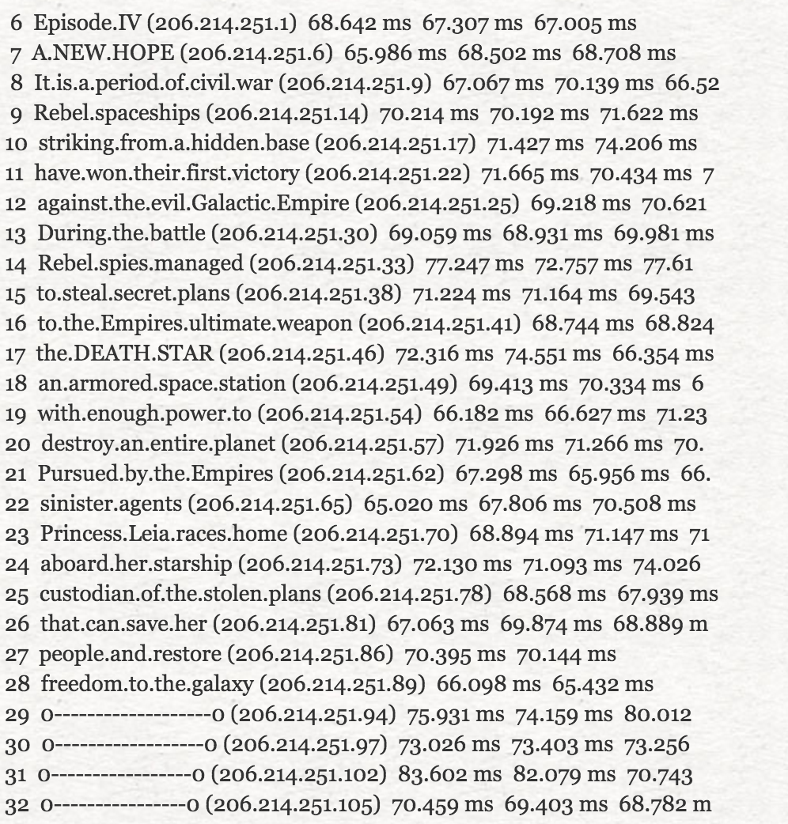
Another traceroute
https://www.youtube.com/watch?v=Hkcdstw0qxU

Slide 79
traceroute
B’s routing table
destination interface/NH
::/0 2001:db8:5::C 2001:db8:2::/47 2001:db8:6::E 2001:db8:5::/48 South 2001:db8:6::/48 East
2001:db8:7::/48 West
RB
2001:db8:7::/48
2001:db8:6::/48
2001:db8:1::/48
2001:db8:5::/48
RA
RC
RE
2001:db8:4::/48
2001:db8:3::/48
2001:db8:2::/48
E’s routing table
destination interface/NH
::/0 2001:db8:6::B
2001:db8:2::/48 East 2001:db8:3::/48 West 2001:db8:6::/48 North
A’s routing table
destination interface/NH
::/0 2001:db8:7::B
2001:db8:7::/48 2001:db8:4::C
2001:db8:1::/48 West
2001:db8:4::/48 East
2001:db8:7::/48 North
C’s routing table
destination interface/NH
2001:db8:1::/48 2001:db8:5::B
2001:db8:2::/47 2001:db8:3::E
2001:db8:2::/48 2001:db8:5::B
2001:db8:3::/48 East
2001:db8:4::/48 West
2001:db8:5::/48 North
2001:db8:6::/48 2001:db8:5::B

Slide 80
How does a host learns its IPv6 address ?
Host contacts a DHCPv6 server on the local network
DHCPv6 Server allocates one IPv6 address belonging to the network prefix to the host for some time
Host needs to renew address allocation regularly
DHCPv6 Server knows which host uses which IPv6 address
Routers regularly broadcast messages announcing the /64 prefix associated to each of their interfaces
ICMPv6
Upon reception of such a message, host can allocate its own address as
Prefix followed by 64 bits identifier
Prefix followed by 64 bits random identifiers
More details will be provided when we will discuss Local Area Networks

Slide 81
IPv6 network configuration of a host
ip -6 addr show lo
1: lo: <LOOPBACK,UP,LOWER_UP> mtu 65536 qdisc noqueue state UNKNOWN group default qlen 1000
inet6 ::1/128 scope host
Loopback interface
Network interface configuration
Address of default router
ip -6 addr show eth0
2: eth0: <BROADCAST,MULTICAST,UP,LOWER_UP> mtu 1500 qdisc fq_codel state UP group default qlen 1000
altname enp0s3
altname ens3
inet6 2001:6a8:308f:9:0:82ff:fe68:e51c/64 scope global
valid_lft forever preferred_lft forever
inet6 fe80::82ff:fe68:e51c/64 scope link
valid_lft forever preferred_lft forever

Slide 82
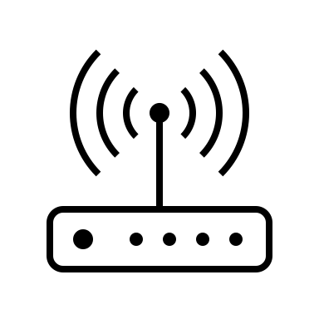

IPv6 addresses are grouped in subnets
All the addresses that belong to the same subnet as the local host can be reached directly through the local area network
The adresses that belong to other subnets are reachable via the default router
Internet
2001:db8:A:B::bad/64
2001:db8:A:B::cafe/64
2001:db8:A:C::dada/64

Slide 83
How can a host obtain its address ?
Manual configuration
Rarely used, except on servers
DHCP
Host contacts DHCPv6 server and receives its own address
Stateless Address AutoConfiguration (SLAC)

Slide 84
IPv6 unicast addresses
128 bits
N bits
M bits
128-N-M bits
interface ID
global routing prefix
subnet ID
Can be used to identify the
ISP responsible for this address
Usually 64 bits
Based on MAC Address
A subnet in this ISP or a customer of this ISP
Notes:
Today, the default encoding for global unicast addresses is to use :
48 bits for the global routing prefix (first three bits are set to 001)
16 bits for the subnet ID
64 bits for the interface ID

Slide 85
IPv6 subnet
A subnet gathers hosts and routers that can directly exchange frames without passing through an intermediate router
2001:db8:1234:5678::BB
2001:db8:1234:5678::1
2001:db8:1234:5678::AA
2001:db8:1234:5678::CC
R
2001:db8:1234:5678::/64
What are the IPv6 addresses that belong to the 2001:db8:1234:5678::/64 prefix ?

Slide 86
Why using subnets ?
Improves network scalability
Routers maintain routes per subnet or per groups of subnets
Allows to group hosts together
Students in different subnet than staff
Servers in different subnet than laptops
What is the size in bits of the IPv6 subnet that your ISP allocates you at home ?

Slide 87
Datalink layer service
Unreliable connectionless service
Each device is identified by a 48 bits MAC address
To send a frame using the datalink layer service, the network layer must know the MAC address of the destination
send(destination, data)

Slide 88
IPv6 link-local addresses
Used by devices on same LAN to exchange IPv6 packets when they don't have/need globally routable address
Each host/router must generate one link local address for each of its interfaces
Each IPv6 host uses several IPv6 addresses
128 bits
10 bits
54 bits
64 bits
interface ID
FE80
0000000000.....00000000000
Notes:
Site-local addresses were defined in the first IPv6 specifications, but they are now deprecated and should not be used.
Recently “private” addresses have been defined as Unique Local IPv6 Addresses as a way to allow entreprise to obtain IPv6 addresses without being forced to request them from providers or RIRs.
The way to choose such a ULA prefix is defined in :
R. Hinden, B. Haberman, Unique Local IPv6 Unicast Addresses, RFC4193, October 2005
Recently, the case for a registration of such addresses has been proposed, see :
R. Hinden, G. Huston, T. Narten, Centrally Assigned Unique Local IPv6 Unicast Addresses, internet draft, <draft-ietf-ipv6-ula-central-02.txt>, work in progress, June 2007
See also
http://www.ripe.net/ripe/policies/proposals/2007-05.html -

Slide 89
Router advertisements
Maximum hop limit to avoid spoofed packets from outside LAN
Ver Tclass
Flow Label
Value of hop limit to be used by hosts when sending IPv6 packets
Payload Length
58 255
Router IPv6 address
(link local)
The lifetime associated with the default router in units of seconds. 0 is the router sending the advertisement is not a default router.
FF02::1
(all nodes)
The time, in milliseconds, that a node assumes a neighbour is reachable after having received a reachability confirmation.
Type:134 Code : 0
Checksum
CurHLim
M O Res
Router lifetime
Reachable Time
Retrans Timer
The time, in milliseconds, between retransmitted Neighbor Solicitation messages.
Options
MTU to be used on the LAN
Prefixes to be used on the LAN
Notes:
When the M bit is set to true, this indicates that IPv6 addresses should be obtained from DHCPv6
When the O bit is set to true, this indicates that the hosts can obtain additional information (e.g. address of DNS resolver) from DHCPv6
The router advertisements messages can also be sent in unicast in response to solicitations from hosts. A host can obtain a router advertisement by sending a router solicitation which is an ICMPv6 message containing only the router solicitation message (type 133).

Slide 90
RA options
Format of the options
MTU option
Prefix option
Type Length
Options
Options (cont.)
Type : 5 Length:1
Reserved
MTU
Type : 3 Length:4
PreLen
L A Res.
Number of bits in IPv6 prefix that identify subnet
Valid Lifetime
Preferred Lifetime
The validity period of the prefix in seconds
Reserved2
IPv6 prefix
The duration in seconds that addresses generated from the prefix via stateless address autoconfiguration remain preferred.
Notes:
The two L and A bits are defined as follows :
L 1-bit on-link flag. When set, indicates that this
prefix can be used for on-link determination. When
not set the advertisement makes no statement about
on-link or off-link properties of the prefix. In
other words, if the L flag is not set a host MUST
NOT conclude that an address derived from the
prefix is off-link. That is, it MUST NOT update a
previous indication that the address is on-link.
A 1-bit autonomous address-configuration flag. When
set indicates that this prefix can be used for
stateless address configuration.
Other options have been defined for the router advertisements. For example, the RDNSS option defined in
J. Jeong, S. Park, L. Beloeil, S. Madanapalli, IPv6 Router Advertisement Option for DNS Configuration, RFC 5006, Sept. 2007
allows a router to advertise the IPv6 address of the DNS resolver to be used by hosts on the LAN.

Slide 91
Neighbour discovery
1
IPv6: 1080:0:0:0:8:A
Eth : A
IPv6: 1080:0:0:0:8:E
Eth : E
Ipv6: 1080:0:0:0:8:C
Eth : C
1080:0:0:0:8:A wants to send a packet to 1080:0:0:0:8:C
2
IPv6: 1080:0:0:0:8:A
Eth : A
IPv6: 1080:0:0:0:8:E
Eth : E
Ipv6: 1080:0:0:0:8:C
Eth : C
Neighbour solicitation: Addr Eth 1080:0:0:0:8:C ? sent to IPv6 multicast address
3
IPv6: 1080:0:0:0:8:A
Eth : A
IPv6: 1080:0:0:0:8:E
Eth : E
Ipv6: 1080:0:0:0:8:C
Eth : C
Neighbour advertisement: 1080:0:0:0:8:C is reachable via Ethernet Add : C
Notes:
The transmission of IPv6 packets over Ethernet is defined in :
M. Crawford, Transmission of IPv6 Packets over Ethernet Networks, RFC2464, December 1998
Note that in contrast with ARP used by IPv4, ICMPv6 neighbour solicitation messages are sent to a multicast ethernet address and not to the broadcast ethernet address. This implies that only the IPv6 enabled hosts on the LAN will receive the ICMPv6 message.

Slide 92
ICMPv6 Neighbour Discovery
Neighbour solicitation
Neighbour advertisement
Type : 135 Code:0
Checksum
The IPv6 address for which the link-layer (e.g. Ethernet) address is needed.
May also contain an optional field with the link-layer (e.g. Ethernet) address of the sender.
Reserved
Target IPv6 Address
R : true if node is a router
S : true if answers to a neighbour solicitation
Type : 136 Code:0
Checksum
R S O Reserved
The IPv6 and link-layer addresses
Target IPv6 Address
Target link layer Address
Notes:
The ICMPv6 neighbour discovery messages are sent with HopLimit=255
The role of the R, S and O flags is described as follows in RFC4861
R Router flag. When set, the R-bit indicates that
the sender is a router. The R-bit is used by
Neighbor Unreachability Detection to detect a
router that changes to a host.
S Solicited flag. When set, the S-bit indicates that
the advertisement was sent in response to a
Neighbor Solicitation from the Destination address.
The S-bit is used as a reachability confirmation
for Neighbor Unreachability Detection. It MUST NOT
be set in multicast advertisements or in
unsolicited unicast advertisements.
O Override flag. When set, the O-bit indicates that
the advertisement should override an existing cache
entry and update the cached link-layer address.
When it is not set the advertisement will not
update a cached link-layer address though it will
update an existing Neighbor Cache entry for which
no link-layer address is known. It SHOULD NOT be
set in solicited advertisements for anycast
addresses and in solicited proxy advertisements.
It SHOULD be set in other solicited advertisements
and in unsolicited advertisements.

Slide 93
Autoconfiguration
What happens when a host boots ?
Use Link-local IPv6 address (FE80::/64)
Each interface has a link-local IPv6 address
But another node might have chosen the same address !
R
ICMPv6 Neighbour sollicitation
Ethernet : 0800:200C:417A FE80::M₆₄(800:200C:417A)
Address is valid if nobody answers
Notes:
This utilisation of ICMPv6 Neighbour solicitation is called Duplicate Address Detection. It is used everytime a host obtains a new IPv6 address and is required to ensure that a host is not using the same IPv6 address as another host on the same LAN.

Slide 94
Global IPv6 address
How to obtain the IPv6 prefix of the subnet ?
Wait for router advertisements
Solicit router advertisement
R
ICMPv6 : Router Solicitation
IPv6 Src: FE80::M₆₄(800:200C:417A)
IPv6 Dest: FF02::2
Ethernet : 0800:200C:417A FE80::M₆₄(800:200C:417A)

Slide 95
Global IPv6 address
R
ICMPv6 : Router Advertisement
IPv6 Src: FE80::M₆₄(EthernetR)
IPv6 Dest: FF02::1
IPv6 Prefix = 2001:6a8:1100::/48
Prefix lifetime
Ethernet : 0800:200C:417A FE80::M₆₄(800:200C:417A)
IPv6 addresses are allocated for limited lifetime
This allows IPv6 to easily support renumbering
Notes:
IPv6 is supposed to easily support renumbering and IPv6 router advertisements are one of the ways to perform this renumbering by allowing hosts to update their IPv6 addresses upon
reception of new router advertisement messages. However, in practice renumbering an IPv6 network is not easily because IPv6 addresses are manually encoded in too many
configuration files, see e.g. :
F. Baker, E. Lear, R. Droms, Procedures for Renumbering an IPv6 Network without a Flag Day, RFC4192, 2005

Slide 96
Privacy concerns
Autoconfigured IPv6 addresses contain the MAC address of the hosts
How to maintain privacy with IPv6 ?
Use DHCPv6 and configure server to never reallocate the same IPv6 address
Allow hosts to use random host ids in lower 64 bits of their IPv6 address
algorithms have been implemented to generate such random host ids on nodes with and without stable storage
Notes:
This extension to support privacy-aware IPv6 addresses is defined in
T. Narten, R. Draves, S. Krishnan, Privacy Extensions for Stateless Address Autoconfiguration in IPv6, RFC4941, Sept. 2007

Slide 97
Agenda
TCP
Improvements to the three-way handshake
Improvements to the data transfer
Congestion control (will be discussed later)
Multipath TCP (will be discussed later)
IPv6
IPv6 Addresses
IPv6 Packets
ICMPv6
IPv4

Slide 98
IPv4 addresses
32 bits wide
Public IPv4 addresses
Allocated by IANA and RIRs to ISPs
https://www.iana.org/assignments/ipv4-address-space/ipv4-address-space.xhtml
Private IPv4 addresses
10.0.0.0/8
192.168.0.0/16
172.16.0.0/12
Link local addresses
169.254.0.0/16
Multicast
224.0.0.0 - 239.255.255.255
Reserved
240/4
https://www.rfc-editor.org/rfc/rfc1918

Slide 99
IP version 4
Header extensions, rarely used
Same role as DSCP in IPv6
Max. Packet length 64 KBytes
Packet format
20 bytes header
Ver IHL ToS
Total length
Identification
Flags Frag. Offset
Same role as HopLimit in IPv6
TTL Protocol
Checksum
Source IP address
Destination IP address
Payload
Source port
Destination port
Covers only IP header
6 for TCP, 17 for UDP, …
Sequence number
Acknowledgment number
THL Reserved Flags
Window
Checksum
Urgent pointer
Options
Payload

Slide 100
IPv4 packet carrying a TCP segment
Ver IHL ToS
Total length
Identification
Flags Frag. Offset
IP
TTL Protocol
Checksum
Source IP address
Destination IP address
Source port
Destination port
Sequence number
6 for TCP
Acknowledgment number
TCP
THL Reserved Flags
Window
Checksum
Urgent pointer
Options
Payload

Slide 101
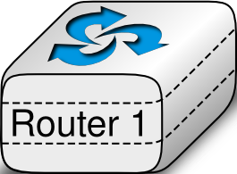
TCP segments processed by a router
Ver IHL ToS
Total length
Ver IHL ToS
Total length
Identification
Flags Frag. Offset
Identification
Flags Frag. Offset
IP
TTL Protocol
Checksum
TTL Protocol
Checksum
Source IP address
Source IP address
Destination IP address
Destination IP address
Source port
Destination port
Source port
Destination port
Sequence number
Sequence number
Acknowledgment number
Acknowledgment number
TCP
THL Reserved Flags
Window
THL Reserved Flags
Window
Checksum
Urgent pointer
Checksum
Urgent pointer
Options
Options
Payload
Payload

Slide 102
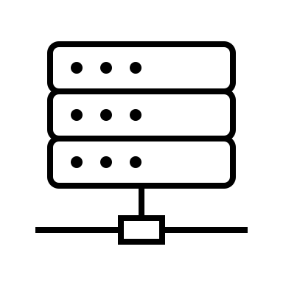

Network Address Translation (NAT)
A NAT allows to share a single public IP address among several hosts
Internet
10.0.0.8
5.6.7.8
1.2.3.4
10.0.0.6
How can a NAT share the same public IP among different hosts using private addresses ?
10.0.0.12
10.0.0.9

Slide 103
TCP segments processed by a NAT
Ver IHL ToS
Total length
Ver IHL ToS
Total length
Identification
Flags Frag. Offset
Identification
Flags Frag. Offset
TTL Protocol
Checksum
TTL Protocol
Checksum
Source IP address
Source IP address
Destination IP address
Destination IP address
Source port
Destination port
Source port
Destination port
Sequence number
Sequence number
Acknowledgment number
Acknowledgment number
THL Reserved Flags
Window
THL Reserved Flags
Window
Checksum
Urgent pointer
Checksum
Urgent pointer
Options
Options
Payload
Payload
Notes:
c

Slide 104
How does a host learns its IPv4 address ?
Host contacts a DHCPv4 server on the local network
DHCPv4 Server allocates one IPv4 address belonging to the network prefix to the host for some time
Host needs to renew address allocation regularly
DHCPv4 Server knows which host uses which IPv4 address
Manual configuration

Slide 105
IPv4 network configuration of a host
ip -4 addr show lo
1: lo: <LOOPBACK,UP,LOWER_UP> mtu 65536 qdisc noqueue state UNKNOWN group default qlen 1000
inet 127.0.0.1/8 scope host lo
valid_lft forever preferred_lft forever
Loopback interface
Network interface configuration
Address of default router
ip -4 addr show eth0
2: eth0: <BROADCAST,MULTICAST,UP,LOWER_UP> mtu 1500 qdisc fq_codel state UP group default qlen 1000
altname enp0s3
altname ens3
inet 130.104.229.28/25 brd 130.104.229.127 scope global eth0
valid_lft forever preferred_lft forever

Slide 106
IPv4 addresses are grouped in subnets
All the addresses that belong to the same subnet as the local host can be reached directly through the local area network
The adresses that belong to other subnets are reachable via the default router
Internet
192.168.0.12/24
192.168.0.23/24
10.0.0.2/23

Slide 107
Reverse DNS
Objective
Query an IPv4 or IPv6 address and retrieve the corresponding DNS name
Solution for IPv4
Convert IPv4 address w.x.y.z into name z.y.x.w.in-addr.arpa
Query DNS for PTR record
dig -t PTR +short 4.4.8.8.in-addr.arpa
dns.google.
dig -t PTR +short 1.1.104.130.in-addr.arpa
ns1.sri.ucl.ac.be.

Slide 108
The IPv4 reverse DNS tree
dig -t NS in-addr.arpa +short
b.in-addr-servers.arpa.
d.in-addr-servers.arpa.
f.in-addr-servers.arpa.
e.in-addr-servers.arpa.
c.in-addr-servers.arpa.
a.in-addr-servers.arpa.
root
com
edu
arpa
dig -t NS 130.in-addr.arpa +short
u.arin.net.
z.arin.net.
y.arin.net.
r.arin.net.
arin.authdns.ripe.net.
x.arin.net.4
In-addr
8
9
130
dig -t NS 102.130.in-addr.arpa +short
ns2.dc.uq.edu.au.
ns1.dc.uq.edu.au.
ns4.dc.uq.edu.au.
ns3.dc.uq.edu.au.
102
103
104
105
106
107
dig -t NS 104.130.in-addr.arpa +short
ns2.sri.ucl.ac.be.
ns3.sri.ucl.ac.be.
ns1.sri.ucl.ac.be.

Slide 109
Reverse DNS for IPv6
Same principle as for IPv4, but with two differences :
Top-level domain is ip6.arpa
Reverse IPv6 address is encoded as a serie of 4 bits nibbles in hexadecimal separated by dots
Example : to find the PTR for 2001:db8::567:89ab we need to query
b.a.9.8.7.6.5.0.0.0.0.0.0.0.0.0.0.0.0.0.0.0.0.0.8.b.d.0.1.0.0.2.ip6.arpa

Slide 110
Traceroute with DNS names
sudo traceroute6 -q 1 -T www.belgium.be
traceroute to www.belgium.be (2a01:690:35:100::f5:79), 30 hops max, 80 byte packets
1 2001:6a8:308f:9::1 (2001:6a8:308f:9::1) 0.664 ms
2 2001:6a8:308f:1::1 (2001:6a8:308f:1::1) 0.617 ms
3 *
4 OSCarnoy-research.sri.ucl.ac.be (fd5b:6a8:3080::4024:52) 0.555 ms
5 FwCarnoy-research.sri.ucl.ac.be (fd5b:6a8:3080::4019:12) 0.501 ms
6 OsCarnoy-default.sri.ucl.ac.be (fd5b:6a8:3080::4019:1) 0.852 ms
7 OSPythagore-default.sri.ucl.ac.be (fd5b:6a8:3080::4020:51) 0.821 ms
8 xe.cr2.brueve.belnet.net.0.0.a.0.8.a.6.0.1.0.0.2.ip6.arpa (2001:6a8:a00:8015::1) 0.970 ms
9 2001:6a8:0:5:1ff::1 (2001:6a8:0:5:1ff::1) 7.109 ms
10 2001:6a8:1:4012::10 (2001:6a8:1:4012::10) 2.152 ms
11 2001:6a8:1:4023::69 (2001:6a8:1:4023::69) 5.057 ms
12 r1.brusou.belnet.net (2001:6a8:8000:8001::1) 4.864 ms
13 smals.r1.brusou.belnet.net (2001:6a8:8000:8001::2) 3.939 ms
14 2a01:690:1:27::1 (2a01:690:1:27::1) 3.225 ms
15 2a01:690:35:1::5 (2a01:690:35:1::5) 3.347 ms
16 *
17 *
18 2a01:690:35:2::2 (2a01:690:35:2::2) 3.377 ms
19 2a01:690:35:2::4 (2a01:690:35:2::4) 3.313 ms
20 2a01:690:35:100::f5:79 (2a01:690:35:100::f5:79) 3.448 ms

